Slide 1

Smart Contract Summary & Q&A Assistant
A Production-Ready RAG Solution
High‑precision Retrieval-Augmented Generation with Google's Gemini.
By ENG. Asser Almasry

Slide 2

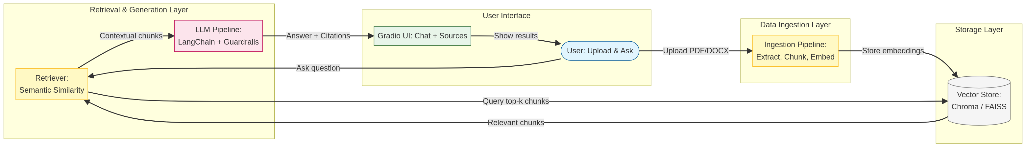
Comprehensive Technology Stack Powering the Assistant
AI & Frameworks
Storage & Processing
Interface & Safety
LangChain
Chroma DB
Gradio
Orchestrates the RAG pipeline with modular LCEL logic.
High-performance vector database for semantic retrieval.
Professional web interface for document Q&A.
LangServe
Gemini 2.5 Flash
PyMuPDF
Exposes the RAG chain as a production REST API.
High-speed reasoning and natural language generation.
Robust PDF text extraction and processing.
NeMo Guardrails
Docx2txt
Multi-layered safety and hallucination prevention.
HuggingFace
Specialized loader for Microsoft Word documents.
Local embeddings using all-MiniLM-L6-v2.

Slide 3
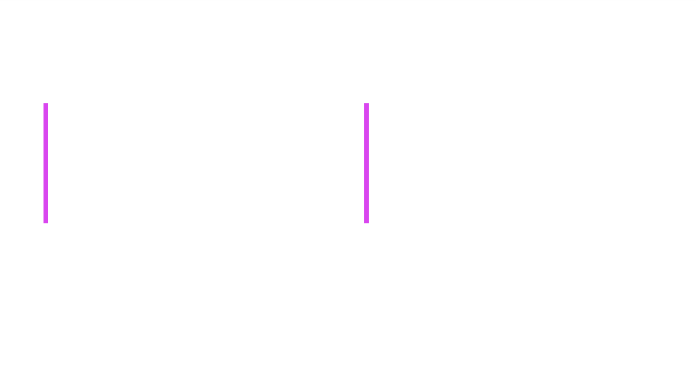
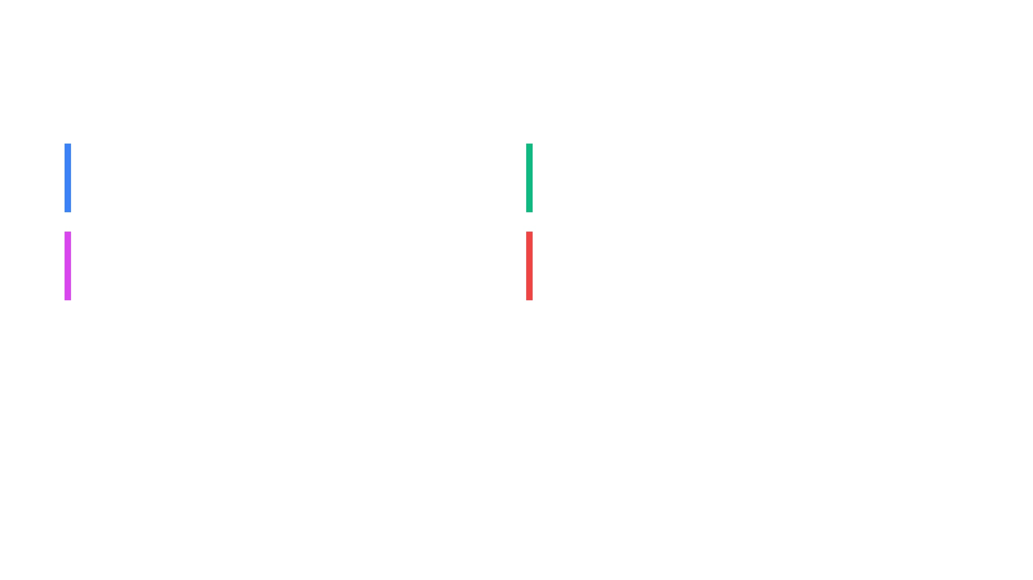
Precision Retrieval and Generation with Gemini
Semantic Search
Expert Persona
Identifies the top 5 most relevant document chunks for every query using high-dimensional vector similarity.
LLM is prompted as a "Legal and Technical Analyst," ensuring professional tone and precise terminology.
Contextual Intelligence
Zero-Speculation Policy
Gemini 2.5 Flash-Lite processes retrieved context to generate answers strictly grounded in the source text.
Built-in instructions prevent the model from hallucinating or speculating beyond the provided contract terms.
Seamless Interaction via Gradio and LangServe
Intuitive UI
Real-Time Feedback
Professional Gradio interface with a dual-panel layout for document management and interactive chat.
Instant ingestion status, chunk counts, and interactive Q&A with formatted citations.
API-First Design
Developer-Friendly
Integrated LangServe exposes the RAG chain as a REST API for enterprise workflow integration.
Built-in sample contracts and "Clear Database" functionality for rapid testing and iteration.

